Slide 1
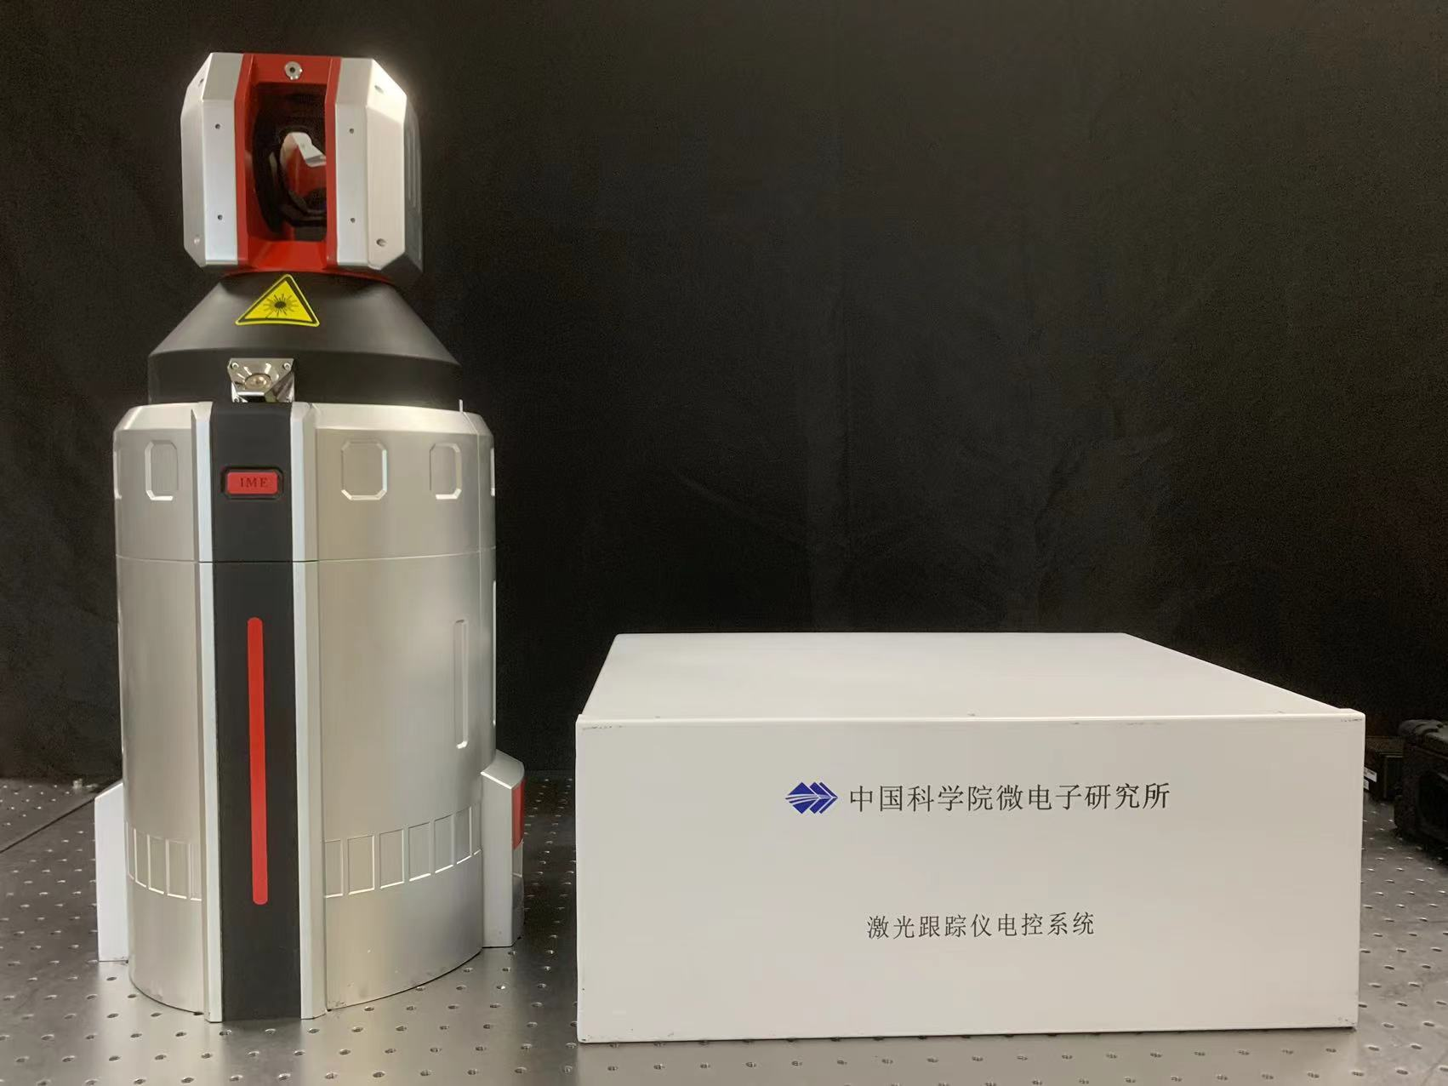
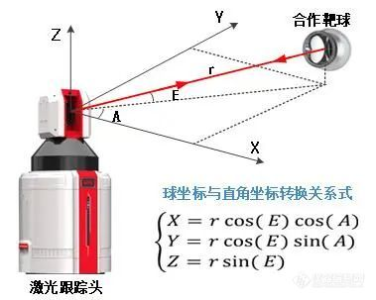
Cooperative Target Sphere
Electrical Control Cabinet
The conversion between
spherical and Cartesian coordinates
Laser Tracker

Slide 2
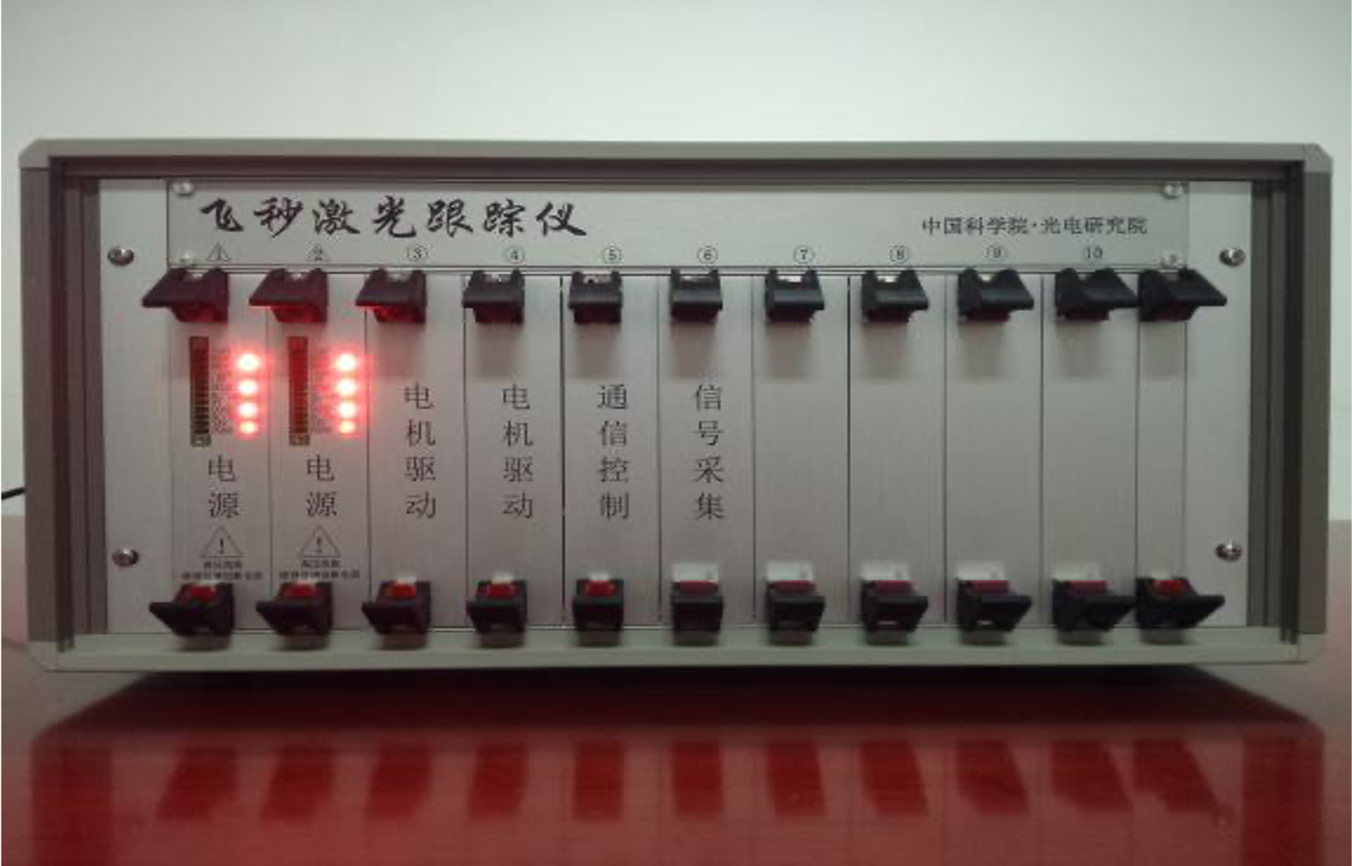
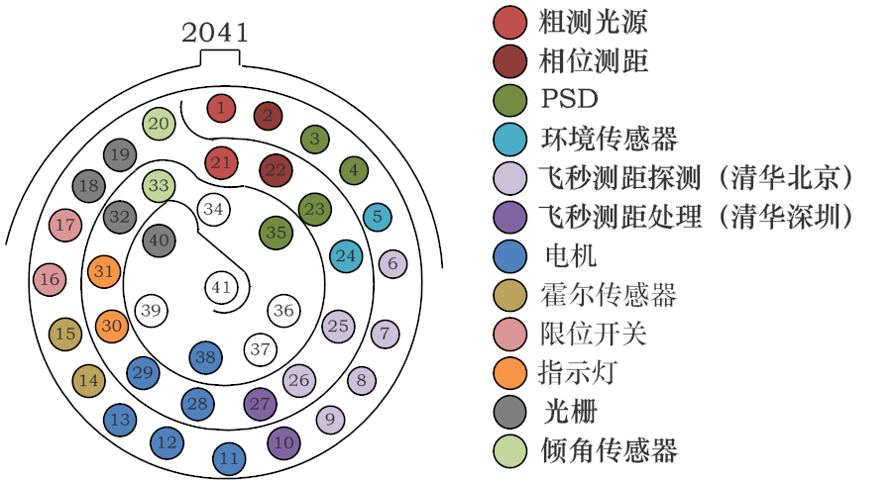
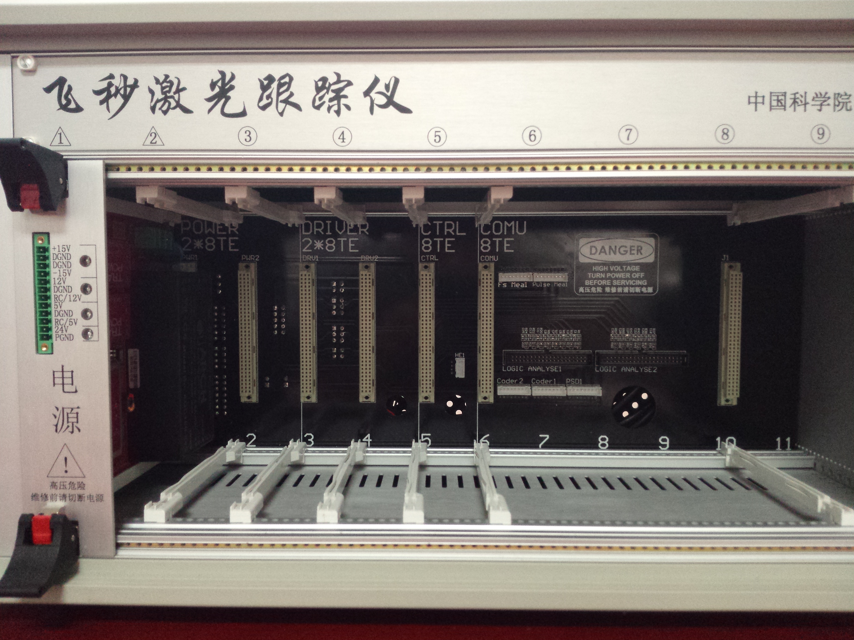
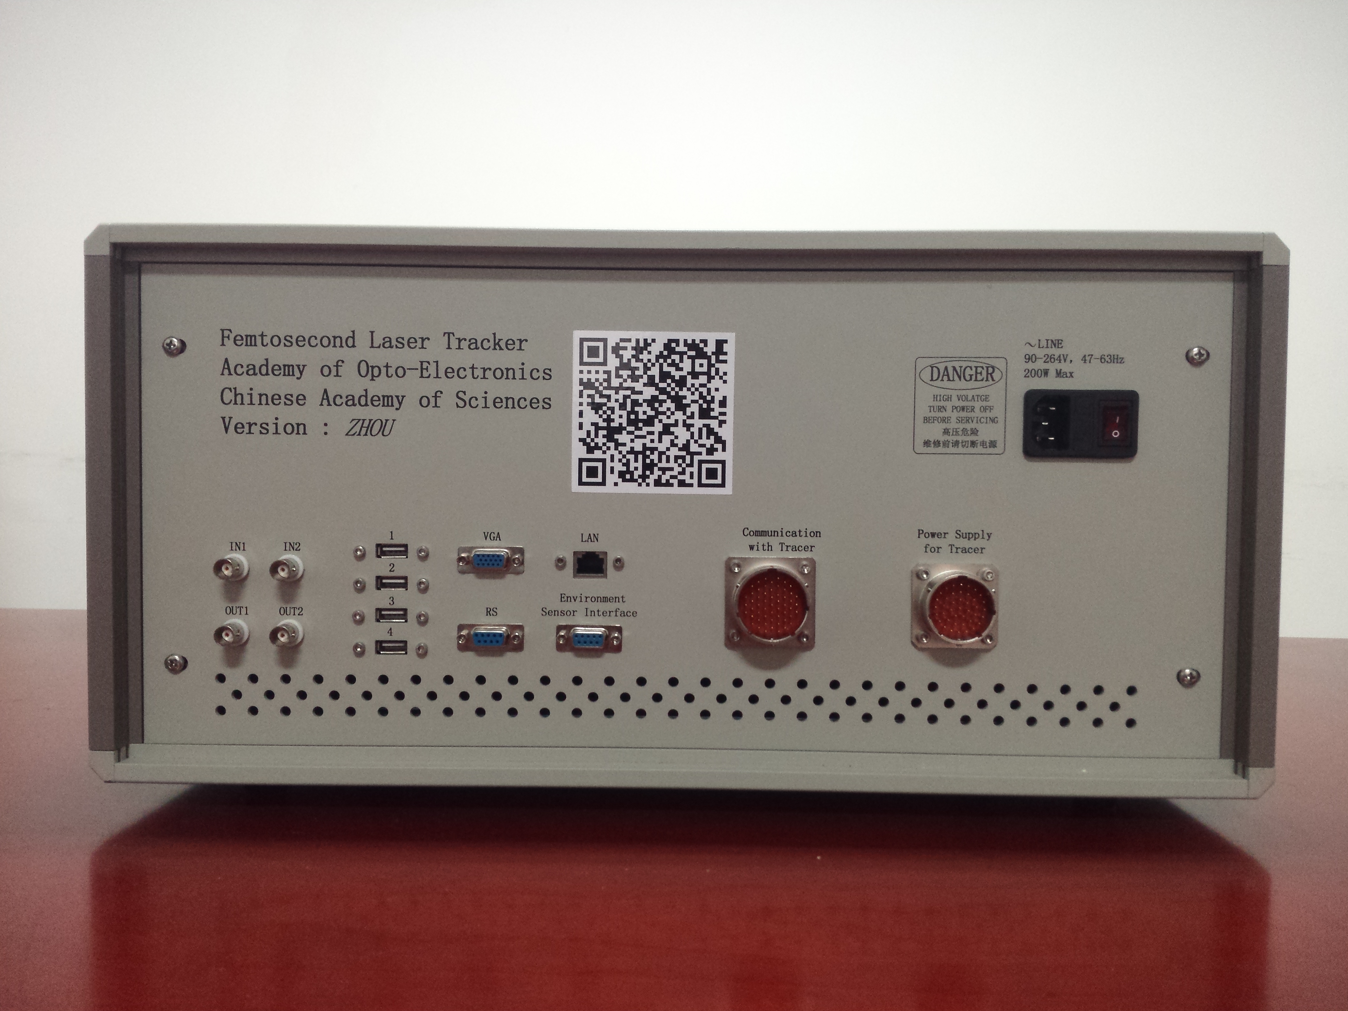
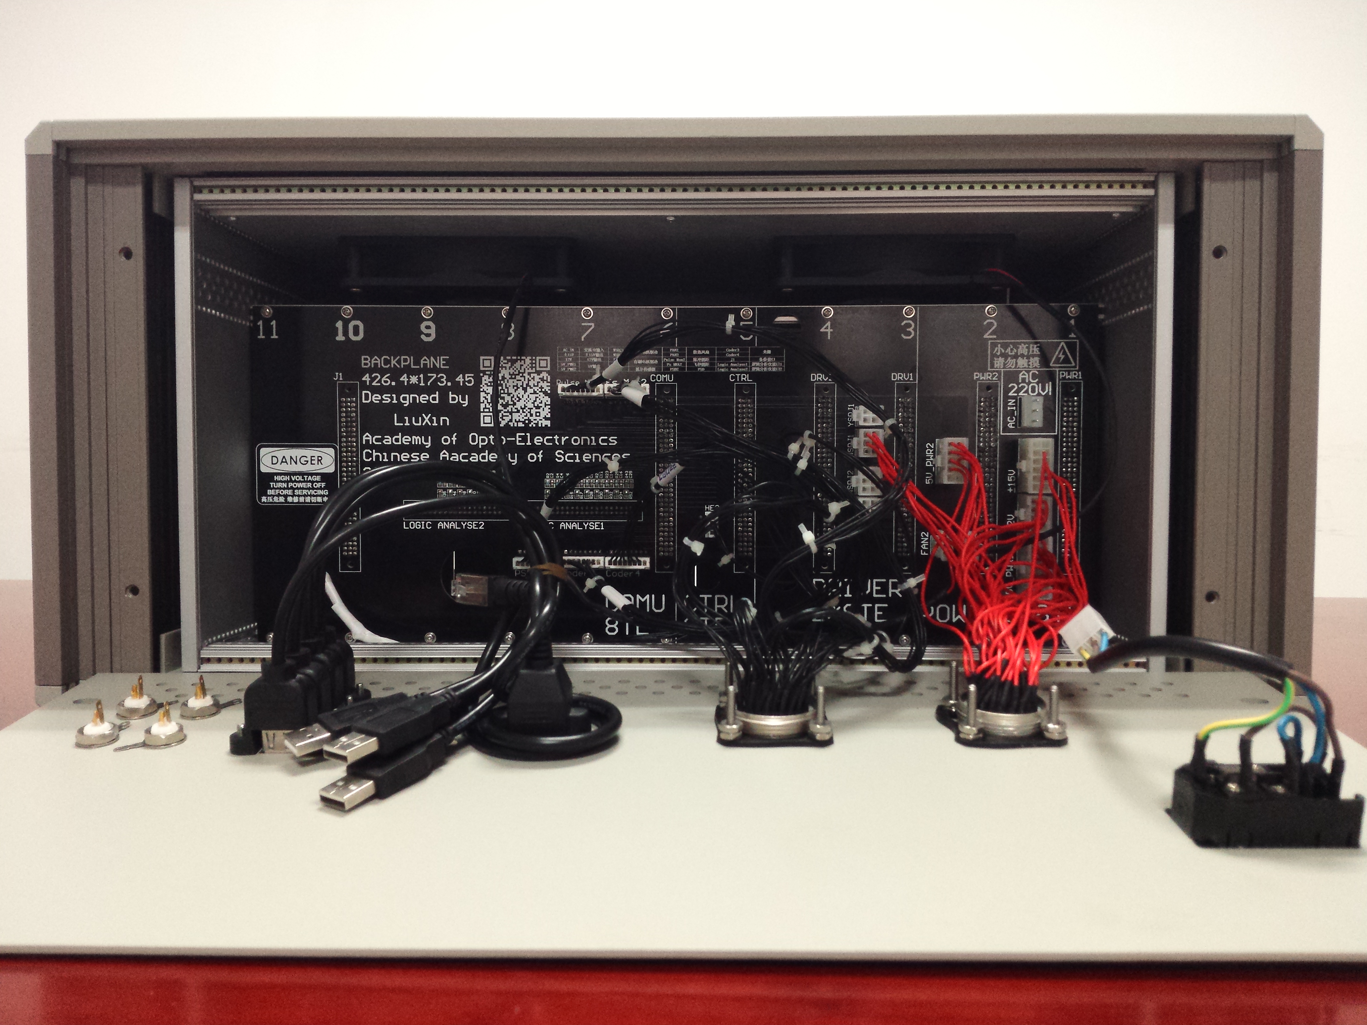
Motor Driver
LD Power Supply
Power Supply
Control
Communication
Phase Ranging
Position Sensor
Environmental Sensor
Motor Controller
Femtosecond Detection
Femtosecond Process
Motor Controller
Motor Controller
Hall Sensor
Limit Switch
Indicator
Front View of Electrical Control Cabinet
Grating Sensor
Tilt Sensor
Interior Front View
Interior Front View
Rear View
Interior Rear View

Slide 3
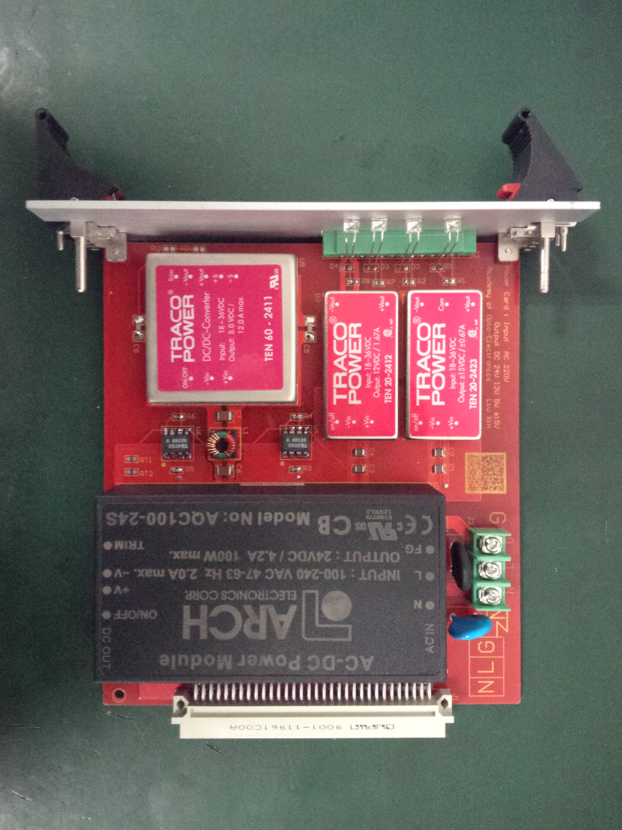
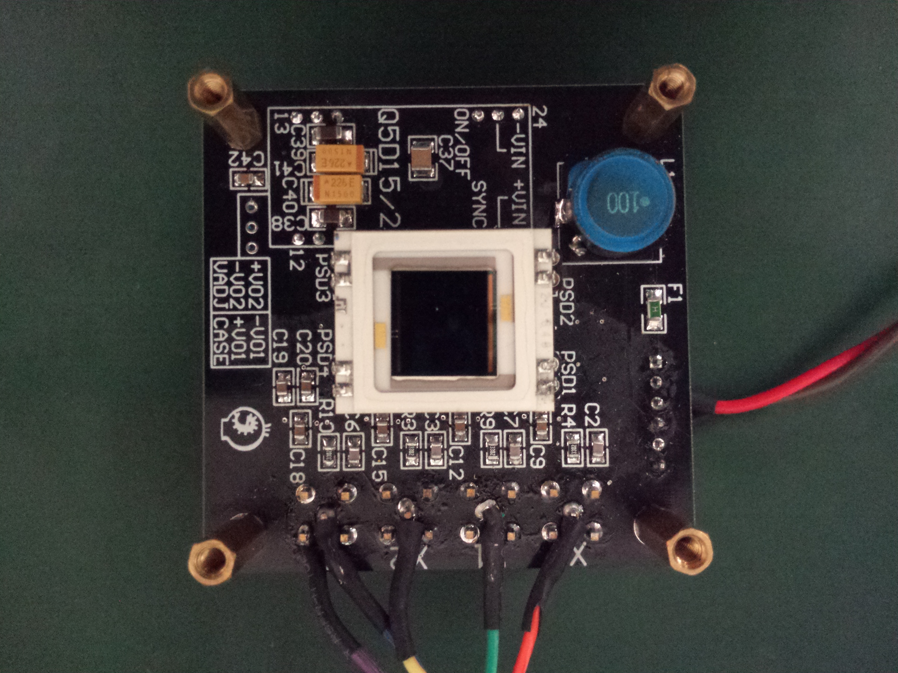
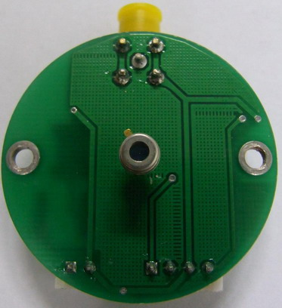
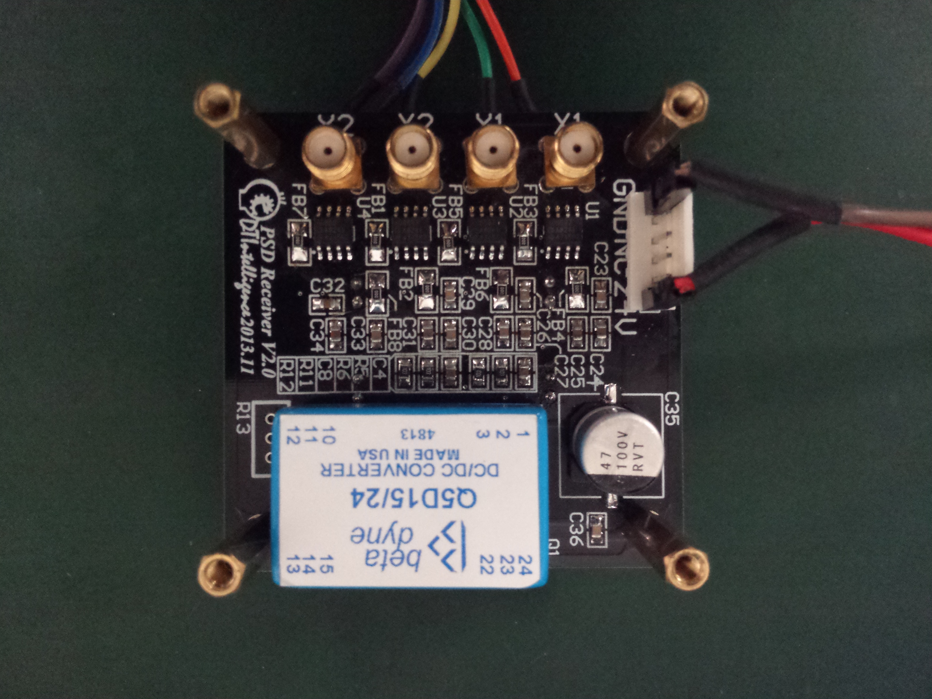
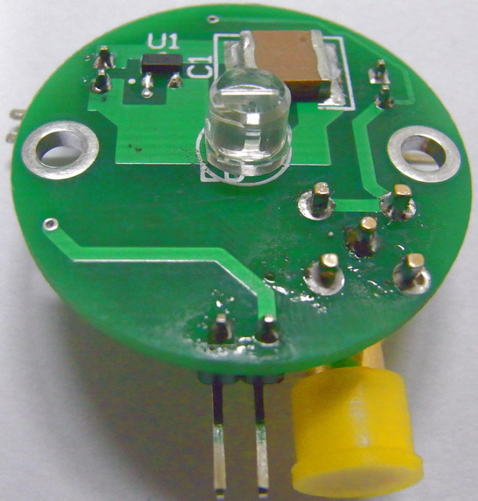
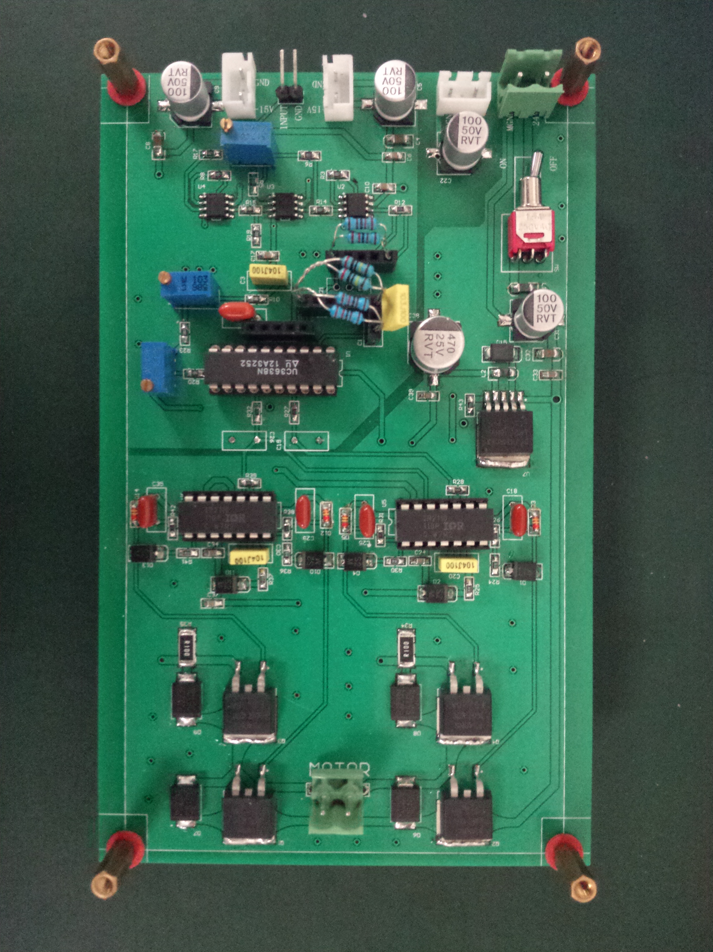
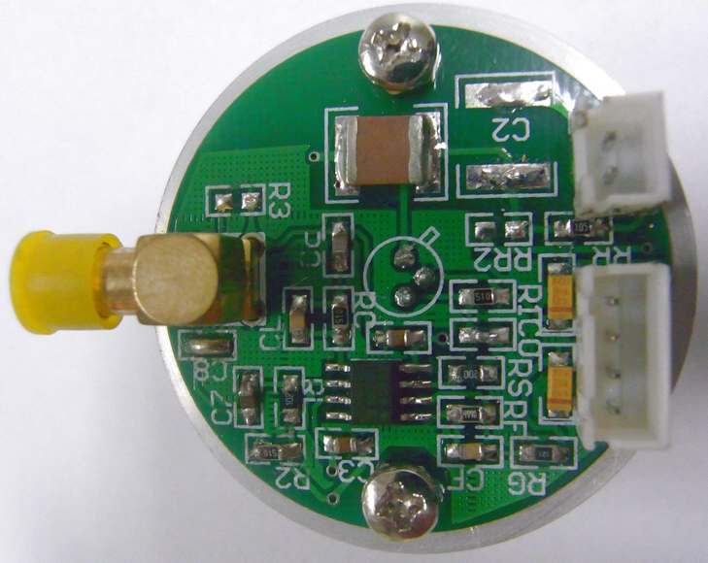
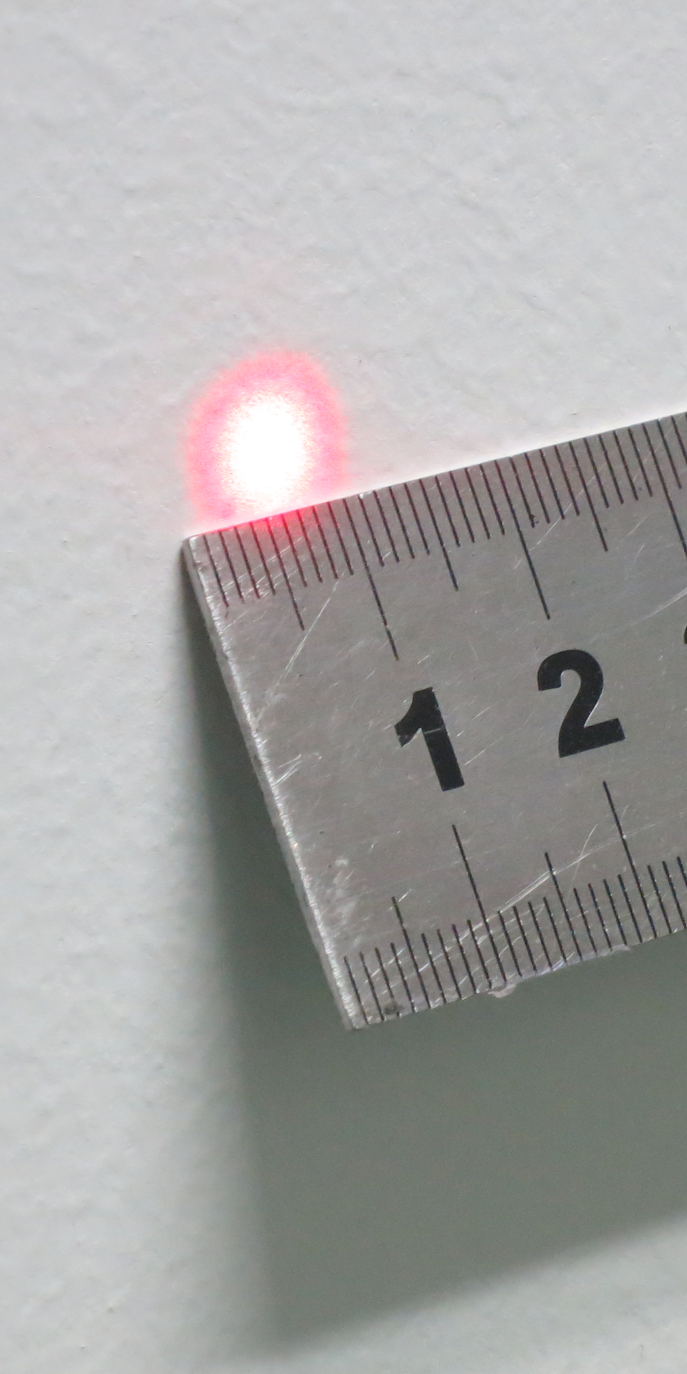
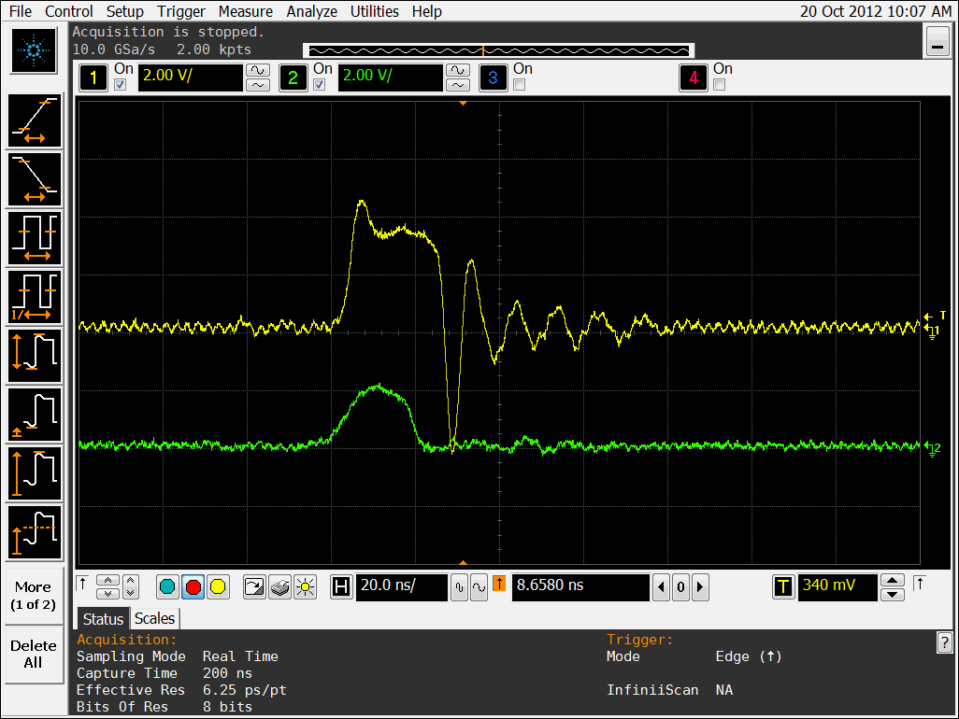
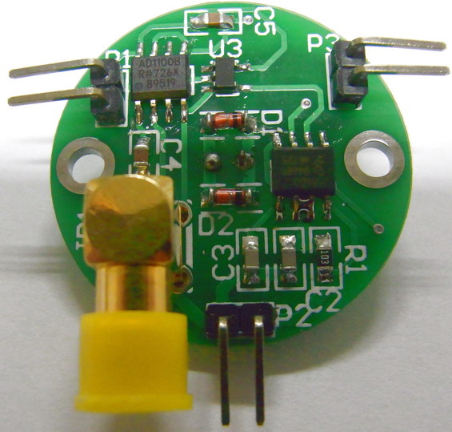
Power Supply
Laser Rangefinder Processor
Position-Sensitive Detector
Emitting Diode
Photodiode
Test
DC Motor Driver

